Slide 1


Writing the Introduction
DP-301P
Interactive Socio-Technical Practicum (ISTP)

Slide 2


Before you begin, start by concept mapping:
Concept mapping is a visual tool used to organize and connect ideas and information. It involves creating a diagram or map that illustrates the relationships between different concepts. Here are the general steps to follow for concept mapping:
Identify the central concept
Brainstorm related ideas
Organize the ideas
Identify relationships
Add cross-links
Revise and refine
Use the map

Slide 3
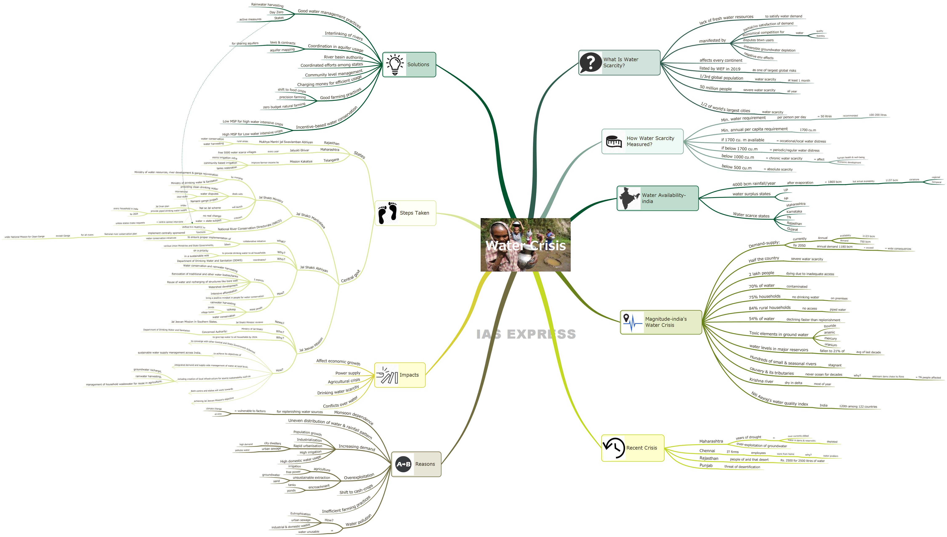

Slide 4

Step 1
Identify the central concept: Start by identifying the main concept that you want to explore. This will be the central idea of your concept map.

Slide 5
Step 2
Brainstorm related ideas: Brainstorm all the related ideas, sub-concepts, or elements that are associated with the central concept. Write down these ideas around the central idea.

Slide 6
Step 3
Organize the ideas: Look for connections between the ideas and group them into categories. Arrange the ideas on a table or a large sheet of paper. You can use a software tool specifically designed for concept mapping.

Slide 7

Step 4
Identify relationships: Identify the relationships between the categories and the sub-concepts. Use arrows or lines to connect related ideas.

Slide 8
Step 5
Add cross-links: Look for connections between categories that are not immediately obvious. Create cross-links between categories and sub-concepts where there is a relationship or interaction.

Slide 9
Step 6
Review the concept map and revise it as necessary. Make sure that the map is clear, concise, and accurately represents the relationships between the different concepts.

Slide 10
Step 7
Use the map: Once the concept map is complete, use it as a tool for organizing your thoughts, brainstorming ideas, or presenting information to others.

Slide 11
Before you begin, develop a clear set of goals:
1. Define the project scope: Clearly define the project scope, which includes the objectives, requirements, and deliverables. This will help to identify the goals that align with the project scope.
2. Identify the project stakeholders: Identify the key stakeholders who are affected by the project or have a vested interest in the project's success. This will help to ensure that the project goals are aligned with the stakeholders' needs.
3. Identify the project's purpose: Identify the primary purpose of the project. The project's purpose should align with the organization's mission, values, and strategic objectives.
4. Conduct a SWOT analysis: Conduct a SWOT analysis to identify the project's strengths, weaknesses, opportunities, and threats. This analysis will help to identify the goals that will maximize the project's strengths and opportunities while minimizing its weaknesses and threats.
5. Identify the desired outcomes: Identify the desired outcomes of the project. These outcomes should be specific, measurable, achievable, relevant, and time-bound (SMART) goals. Examples of SMART goals include reducing costs by a certain percentage, improving customer satisfaction ratings, or increasing revenue by a specific amount.
6. Prioritize the goals: Prioritize the goals based on their importance and the impact they will have on the project's success. This will help to ensure that the project team focuses on the most critical goals first.
7. Communicate the goals: Communicate the goals to the project team, stakeholders, and other relevant parties. This will help to ensure that everyone is aware of the project goals and can work towards achieving them.
8. Monitor and adjust the goals: Monitor the project's progress and adjust the goals as necessary. This will help to ensure that the goals remain relevant and achievable as the project progresses.

Slide 12
Basic Structure of the Introduction:
Start with a hook: A good introduction should start with a hook that grabs the reader's attention and makes them want to read on. This could be a provocative statement, an interesting fact, or a compelling question.
Provide context: After the hook, it is important to provide some context for the article. This could involve giving a brief overview of the topic, explaining why it is important, and outlining the key questions or issues that the article will address.
Review the literature: Depending on the type of social science article you are writing, it may be necessary to provide a brief review of the existing literature on the topic. This can help to establish the research gap that your article is addressing and show how your work fits into the broader scholarly conversation.
Outline the argument: Finally, it is important to outline the argument, hypothesis, or main points that the article will make. This could involve providing a roadmap of the article, explaining the structure of the argument, or outlining the key findings or conclusions that the article will present.

Slide 13
The Introduction moves from the general to the particular, the opposite direction of the arguments you present in the discussion.
general context
the problem
your goals
& objectives

Slide 14

Framing the introduction:
Step 1
In one or two paragraphs, discuss the CONTEXT of your project. (social conditions, pertinent geo-political issues, etc.)
Step 2
In two or three paragraphs, identify the specific PROBLEM. (what problems are the stakeholders facing? What is the ideal situation?)
Step 3
In two or three paragraphs, discuss the IMPORTANCE of your project (highlight the gap or how you will refine/extend the existing system.
Step 4
In one paragraph, write your team’s primary GOAL. (make it realistic and feasible)
Step 5
In the final paragraph, outline your OBJECTIVES towards accomplishing your goal.

Slide 15

Examples from the past year’s ISTP Projects

Slide 16
Try to address these basic questions:
What am I studying?
Why is it important?
What was common knowledge before this study?
How will this study advance knowledge?

Slide 17

Working as a Team:
All together?
Small sections apart?
Multiple rough drafts?
Rotating editor?
One sentence at a time?

Slide 18
Some tips for working effectively as a team:
Establish Goals
Make sure everyone on the team understands the goals and objectives of the project or task.
Communicate
Keep everyone on the team informed about the progress, challenges, and changes in the project. Encourage open and honest communication to avoid misunderstandings or conflicts.
Divide Tasks and Roles
Assign specific tasks and roles to each team member based on their strengths and expertise. Make sure everyone understands their responsibilities and deadlines.
Build Trust
Establish an environment of trust and respect, where team members feel comfortable sharing their ideas and concerns. Encourage a culture of constructive feedback and acknowledge everyone's contributions.
Foster Collaboration
Encourage team members to work together, share ideas, and help each other to achieve the team's goals.
Resolve Conflicts
Address conflicts or disagreements as soon as they arise. Encourage team members to express their concerns and work together to find solutions.
Celebrate Success
Recognize and celebrate the team's successes and accomplishments. Celebrate milestones, progress, and achievements to build morale and motivation.

Slide 19
Build your vocabulary:
Stakeholders: those for whom your project will have an impact of some kind (both positive or negative).
Sponsoring agency: NGO? School? IIT Mandi?
Site description: the community or region or organization in which your project takes place.
Avoid using informal language, words such as “stuff, can’t, wanna, FYI, you, I, cool, !!)

Slide 20
General Style Guidelines
Use the active voice.
Use relevant and reliable sources to support your study.
Use keywords that are pertinent.
Include a clearly identifiable hypothesis.

Slide 21
Tips for Concise Writing:
1) Writing in active tense, beginning with the subject (who).
The decision to hire farmers was made by the state government.
2) Use meaningful, visual verbs.
The artists found it interesting and wanted to learn more .
3) Avoid using state-of-being verbs (to be).
Villagers discussed the new program that was to be held next year.
It is important to note that not everyone was happy about the idea.

Slide 22
Some Additional Tips: WOW! (Waste of Words)
Redundancy means superfluity or using words unnecessarily or using words for a second time.
Avoid saying the same thing twice.
12 midnight
3 am in the morning
End result
Enclosed herewith
Free gift
New innovation
Personal opinion
Refer back
Repeat again
Surrounding circumstances
ATM machine

Slide 23
Vague words that you should generally avoid:
"Thing" - "That thing over there" does not specify what "thing" is being referred to.
"Stuff" - "Put your stuff away" does not specify what specific items are being referred to.
"Good" - "This is a good product" does not specify what makes the product good or what specific qualities it possesses.
"Bad" - "This is a bad idea" does not specify what makes the idea bad or what specific problems it presents.
"Important" - "This is an important meeting" does not specify what makes the meeting important or what specific topics will be covered.
"Nice" - "That was a nice thing to do" does not specify what specifically was nice about the action.
"Interesting" - "That was an interesting lecture" does not specify what specifically was interesting about the lecture.
"Big" - "This is a big project" does not specify how big the project is or in what way it is big.
"Small" - "This is a small company" does not specify how small the company is or in what way it is small.
"Seems" - "It seems like a good idea" does not provide certainty or clarity about the idea being discussed.

Slide 24

Contact
Thank you and all the best with writing your Introductions for the ISTP Project!
For any queries, please write to:
thirthankar@iitmandi.ac.in

